Slide 1
Language Change
Jul 19, 2019, S. C. Huang

Slide 2
Outline
Sound Change
Observation
Notation
Knowledge
Comparative Reconstruction
Internal Reconstruction
Alternation
Split of paradigm

Slide 3
How do we know?
Direct attestation
Conservative aspects of a language
Orthography, esp. the language has a long written history
Marginal forms, irregular forms
Reconstruction
Internal reconstruction
Comparative reconstruction

Slide 4
Sound Change

Slide 5
The Neogrammarian Model
Sound change is regular
Sound change has no memory
Sound change ignores grammar
Sound change is inevitable

Slide 6
Sound Change is Regular
/maːtə/ → /meɪ̯t/
/naːmə/ → /neɪ̯m/
/waːstə/ → /weɪ̯st/
/kaːkə/ → /keɪ̯k/
/naːpə/ → /neɪ̯p/

Slide 7
Notation for this change
aː > eɪ̯
ə > ∅

Slide 8
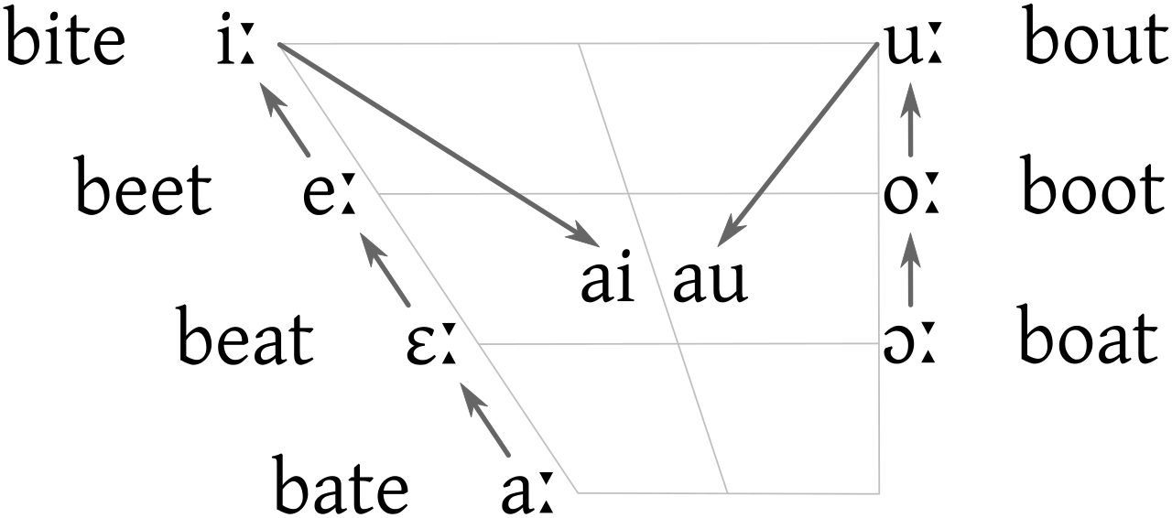
The Great Vowel Shift
Source: https://en.wikipedia.org/wiki/File:Great_Vowel_Shift2c.svg

Slide 9
Another Example
/'kanẽ/ → /'kane/
/'kentũ/ → /'tʃɛnto/
/'kawũ/ → /'kavo/
/'kerwũ/ → /'tʃɛrvo/
/'kibũ/ → /'tʃibo/
/ki'wilis/ → /tʃi'vile/
/'kollũ/ → /'kɔllo/
/'korpus/ → /'kɔrpo/
/ku'kulus/ → /ku'kulo/

Slide 10
Conditioned Change
k > tʃ / _[+front]
There are many other changes in the example.
How many did you see?
(some are conditioned, and some are unconditioned)

Slide 11
Assimilation
Adjacent segments will have similar features
Special types of Assimilation:
Ablaut
Vowel Harmony
Final devoicing

Slide 12
Ablaut & Harmony
Ablaut
Harmony
/foːts/ → /foːt/
/foːtiz/ → /feːt/
/muːs/ → /muːs/
/muːsiz/ → /miːs/
/riːki/ → /riːki/
/kvæːði/ → /kvæːðe/
/urðu/ → /urðu/
/naːmu/ → /naːmo/

Slide 13
Lenition
/ka'pere/ → /ka'βer/
/'lupa/ → /'loβa/
/'mappa/ → /'mapa/
/'statũ/ → /es'taðo/
/'wiːta/ → /'biða/
/'gutta/ → /'gota/
/lo'kare/ → /lo'ɣar/
/a'kuːtũ/ → /a'ɣuðo/
/'wakka/ → /'baka/
/'akʷa/ → /'aɣwa/

Slide 14
Transphonologization
Compensatory Lengthening
<igh> /ix/ → /iː/ → /aɪ̯/
Nasalization
Tonogenesis

Slide 15
Multiple Changes
/'wulɸɑz/ → /'wulf/
/'wulɸoːs/ → /'wulvɑs/
/'hoːɸɑz/ → /'hoːf/
/'hoːɸoːs/ → /'hoːvɑs/
/'hlɑiβɑz/ → /'hlɑːf/
/'hlɑiβoːs/ → /'hlɑːvɑs/

Slide 16
The Order of Changes
ɑz > ∅ / _#
{ɸ, β} > f / _#
{ɸ, β} > v / _
What if the order of the sound changes is reversed?

Slide 17
Suprasegmental Change
ǵéwsoh₂ → ǵéwsoh₂
ǵéwsesi → ǵéwsesi
ǵéwseti → ǵéwseti
ǵéwsowe → ǵewsówe
ǵéwsome → ǵewsóme

Slide 18
When sound change seems irregular
tréyes → þrīz
tu → þū
déḱm̩t → tehun
dʰewbnós → deupaz
pṓds → fōt
bʰréh₂ter → brōþēr

Slide 19
Exception?
nókʷts → nahts
oḱtṓw → ahtōu
steh₂dʰom → stōdą

Slide 20
Exception?
pətḗr → fadēr
ḱm̩tóm → hundą
ǵéwseti → kiusidi

Slide 21
Comparative Reconstruction

Slide 22
Lang S | Lang P | Lang R
/greh/ | /grʲex/ | /grʲex/
/beda/ | /bʲeda/ | /bʲeda/
/peta/ | /pʲẽta/ | /pʲata/
/zet/ | /zʲẽtʲ/ | /zʲatʲ/
/vol/ | /vuw/ | /vol/
/rod/ | /rud/ | /rod/
/sol/ | /sul/ | /solʲ/
Lang S | Lang P | Lang R
/oko/ | /oko/ | /oko/
/noga/ | /noga/ | /noga/
/gos/ | /gẽsʲ/ | /gusʲ/
/roka/ | /rẽka/ | /ruka/
/kura/ | /kura/ | /kura/
/orel/ | /orʲew/ | /orʲol/
/pes/ | /pʲes/ | /pʲos/

Slide 23
Internal Reconstruction

Slide 24
Synchronic clues of diachronic change
Irregularity of morphology
Alternation
Allomorph
Similarity between paradigms
Conservative aspects of language
Similarity between languages

Slide 25
For Example

Slide 26
Alternation
/pleːps/ - /pleːbis/
/urps/ - /urbis/
/daps/ - /dapis/
/ops/ - /opis/
/reːks/ - /reːgis/
/striks/ - /strigis/
/kalks/ - /kalkis/
/kruks/ - /krukis/

Slide 27
Alternation
nature – natural
sane – sanity
serene – serenity
divine – divinity
school – scholarly
profound – profundity
provoke – provocative

Slide 28
Alternation
/ka'tav/ - /jix'tov/
/za'xaʁ/ - /jiz'koʁ/
/ba'dak/ - /jiv'dok/
/sa'val/ - /jis'bol/
/pa'ʕal/ - /jif'ʕal/
/ka'fal/ - /jix'pol/
/xa'faf/ - /jax'pof/
/xa'laf/ - /jaxa'laf/
/ha'ras/ - /jaha'ras/
/ha'fax/ - /jah'pox/

Slide 29
Split of Paradigm
/'pʲɛs/ - /'psɨ/
/'sɛn/ - /'snɨ/
/'kʲɛw/ - /'kwɨ/
/'wɛp/ - /'wbɨ/
/'rut/ - /'rɔdɨ/
/'mur/ - /'mɔrɨ/
/'vus/ - /'vɔzɨ/
/'sat/ - /'sadɨ/
/'var/ - /'varɨ/
/'lis/ - /'lisɨ/
/'ɕmʲɛx/ - /'ɕmʲɛxɨ/
/'lɛp/ - /'lɛpɨ/
/'xlɛp/ - /'xlɛbɨ/
/'dux/ - /'duxɨ/
/'lud/ - /'ludɨ/
/'brut/ - /'brudɨ/

Slide 30
A Famous Example
/bʰer-/ - /bʰeːr-/ - /bʰr̩-/
/dʰeː-/ - /dʰeː-/ - /dʰə-/
/terə-/ - /teːrə-/ - /tr̩ː-/

Slide 31
However
Regular sound change causes morphological irregularity!
Levelling: eliminating of alternation
Old English: cēozan – cēas – curon – gecoren
Modern English: choose – chose – chosen
Analogy:
Old English: sēoðan – sēaþ – sudon – gesoden
Modern English: seethe – seethed – seethed

